Slide 1
Why SOX Compliance Strengthens Database Security Environment
Ivaness Christle Chiong
ITMS 428 – Database Security
Undergraduate Research Paper

Slide 2
Introduction
Current security mechanisms enough?
Strong cryptographic algorithms enough?
Enforcing strong passwords enough?
Just trust Intrusion Prevention/Detection Systems?
WE STILL NEED POLICIES IN PLACE!

Slide 3
Thesis Statement
The SOX Compliance of 2002 strengthens the Database Security Environment because it allows protection of sensitive information, enforces data integrity in databases, and urges control access within the organization.

Slide 4
Protection of Sensitive Information
SOX Compliance Section 302 – Corporate Responsibility for Financial Reports
Chief Executive Officer and Chief Financial Officer
Certify effective internal accounting controls
Quarterly self-assertion under personal liability by CEO and CFO
Disclosure of significant financial information
No supporting documentations or individual assessments needed

Slide 5
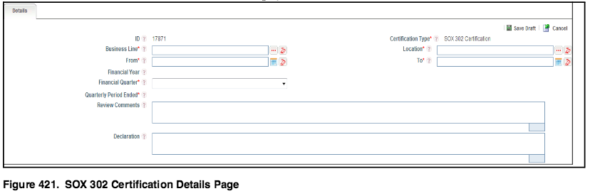
Protection of Sensitive Information

Slide 6
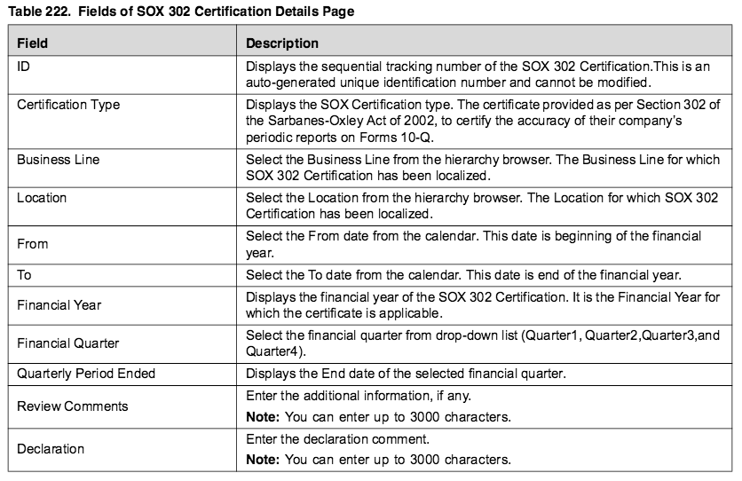

Slide 8
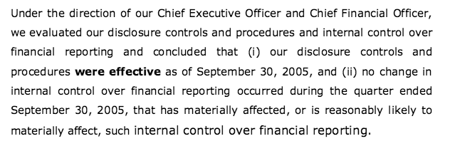
Protection of Sensitive Information
The following is an example of an effective Section 302 report issued by General Electric:

Slide 9
Penalty
Failure to comply with this policy could result to possible lawsuits, loss of investments, negative publicity, and a fine up to 5 million dollars and 20 years imprisonment if a certification was submitted incorrectly.
(Sarbanes-Oxley 101)

Slide 10
Enforces Data Integry
SOX Compliance Section 802 – Criminal penalties for altering documents
SOX Compliance Section 1102 – Tampering with a record or otherwise impeding and official proceeding
IPLocks Database Security and Compliance Solution – captures data logs and copies events to secure repository
Generate report for successful and failed login
Column level monitoring
Content monitoring

Slide 11
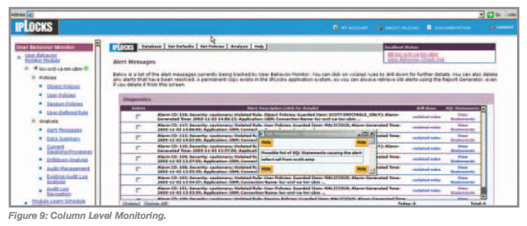

Slide 12
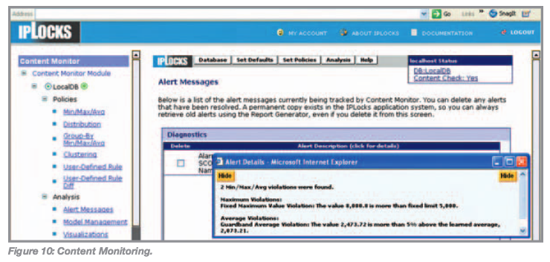

Slide 13
Alternative Solutions
Separate table for recently deleted records and record the person who committed it
Any requests to update records considered critical to the organization in the database should follow change control policies
Triggers that will alert admin when an event occurs such as potential fraud activities
Potentially consider locking columns or rows

Slide 14
Penalty
Whoever attempts to violate these policies could face a huge amount of fine and imprisonment for not more than 20 years.
(Sarbanes-Oxley 101)

Slide 15
Urges Control Access within Organization
SOX Compliance Section 404 – Management assessment of internal controls
Requires documentation and register outside auditors to certify effective internal accounting controls
Mandatory to monitor all users of the database system including DBAs
Malicious DBAs could cover their own tracks!
Solution: Monitoring Privileged User Actions for Security and Compliance

Slide 16
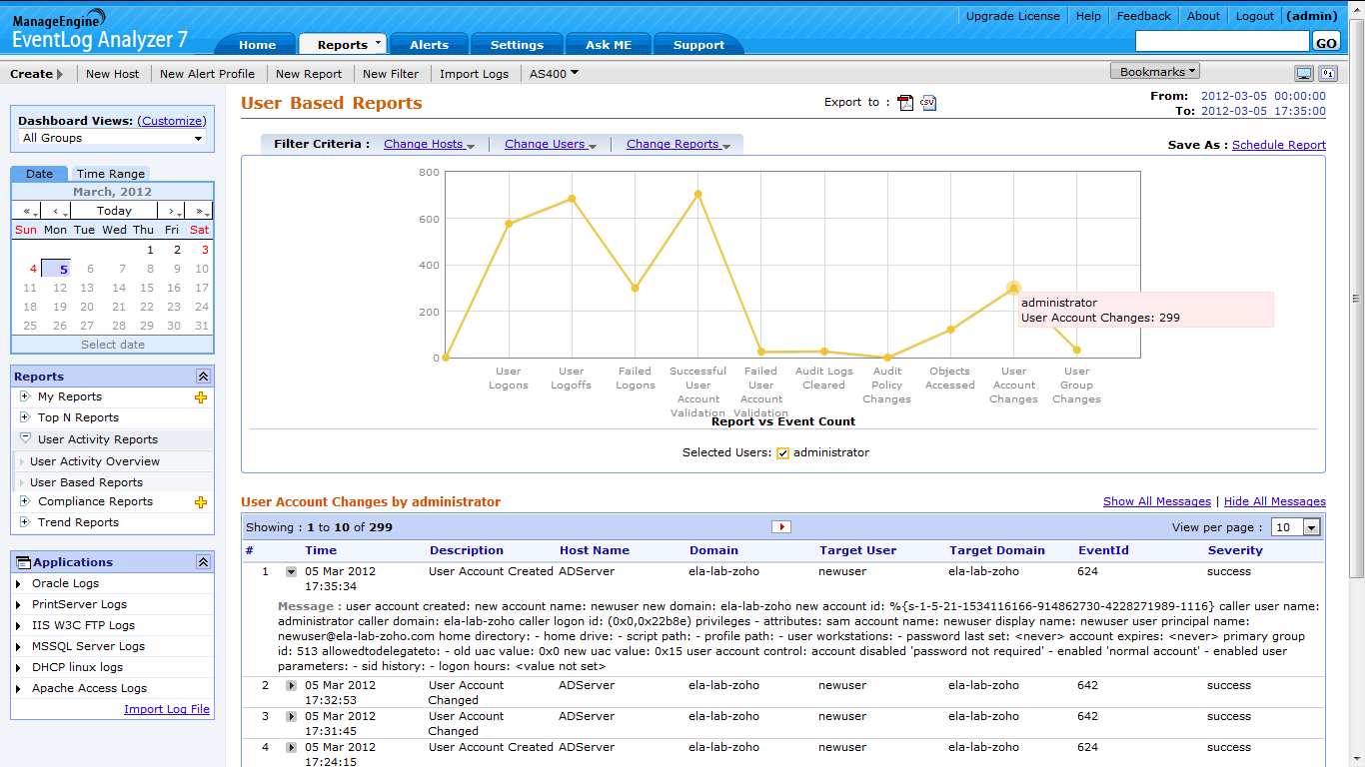
User Based Report using EventLog Analyzer

Slide 17
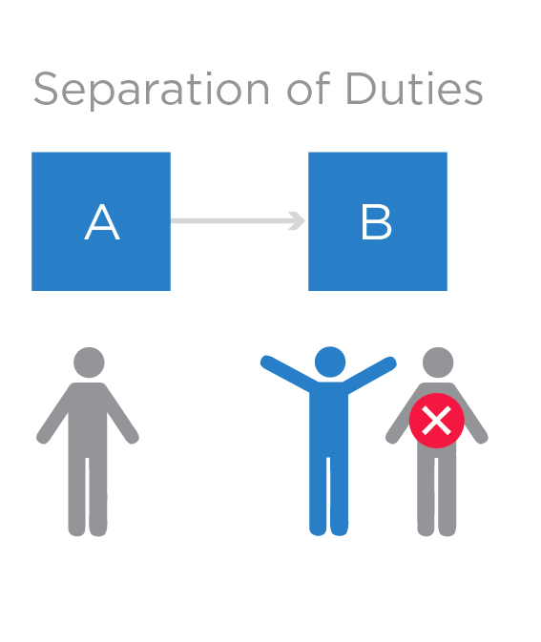
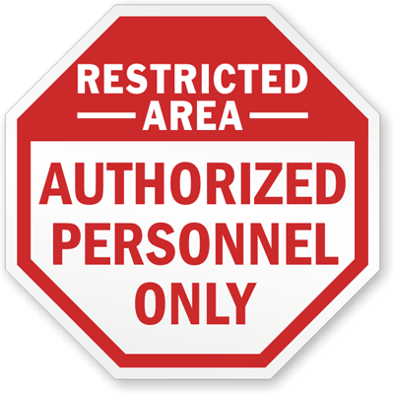

Slide 18
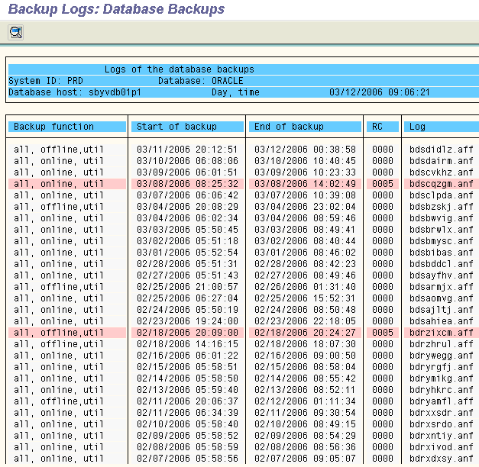

Slide 19
Penalty
Failure to comply with this policy could result to numerous of lawsuits, bad reputation for the company, and a fine up to 1 million dollars and 10 years in prison even if it was just a small thing that was done mistakenly.
(Sarbanes-Oxley 101)

Slide 20
Conclusion
Compliance is heavily used → implementing secure database system
Emphasize protection of organization’s assets
Enforce monitoring of database transactions and its behavior
Minimize inside abuse and outside attacks
People need to be aware of the consequences to obey the policy
Job especially by IT Security Professionals

